Slide 1



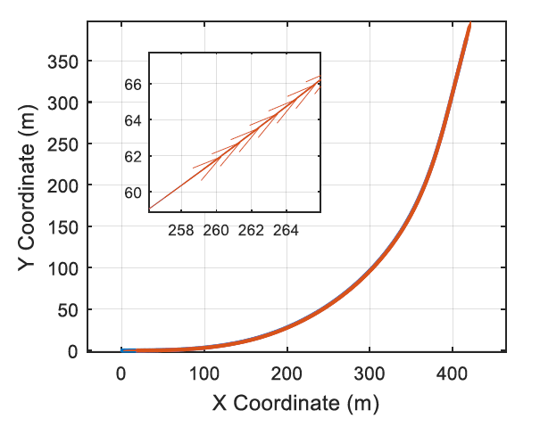
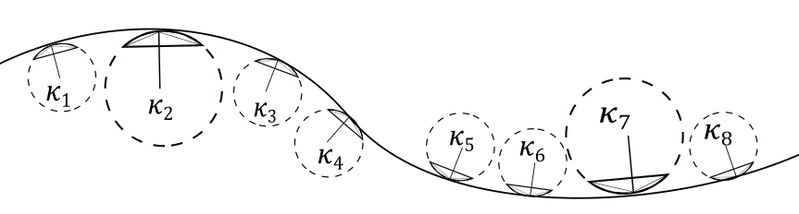
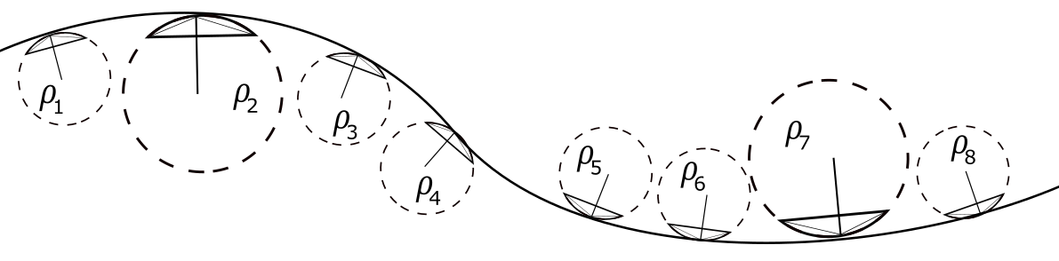
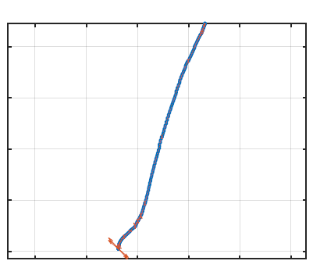
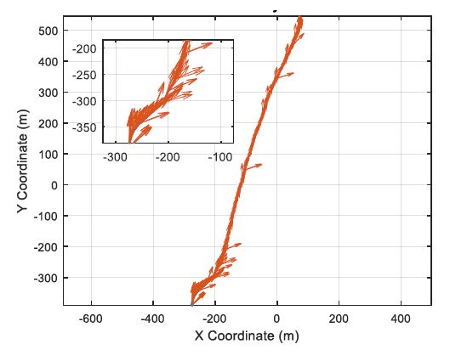
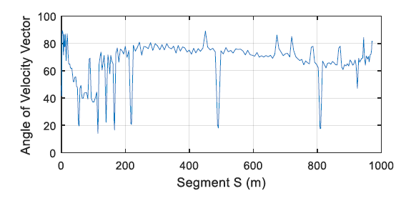
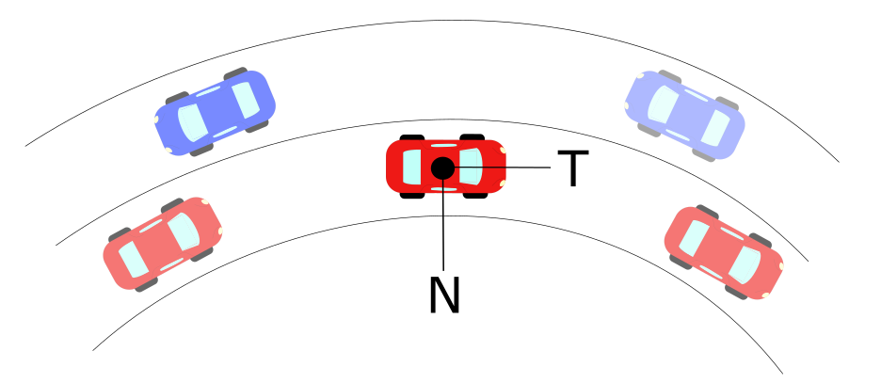
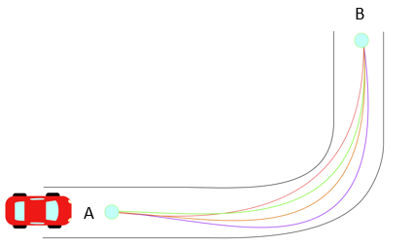
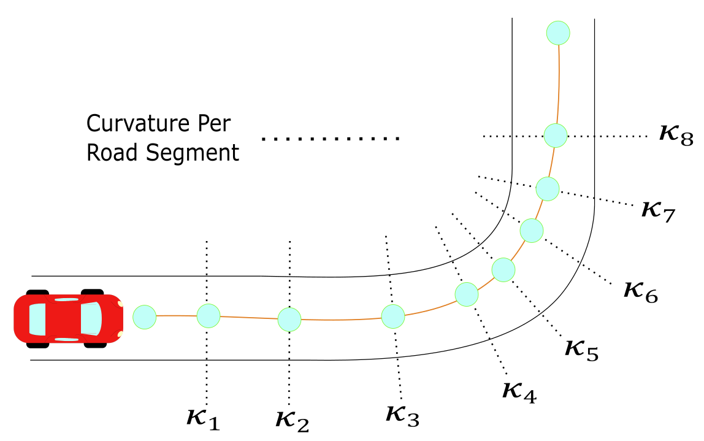
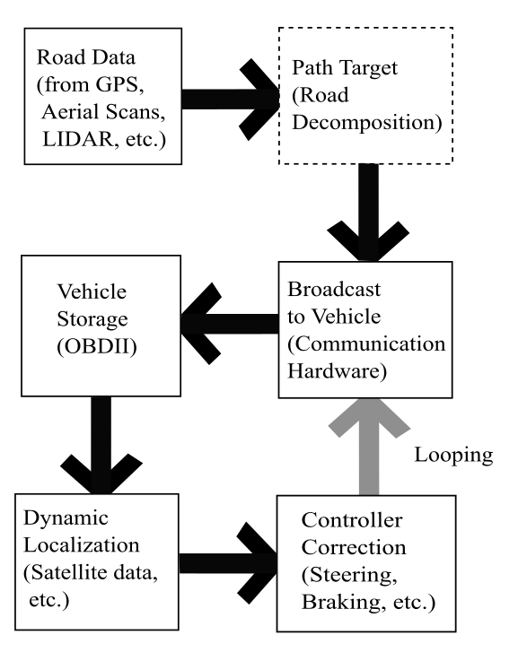
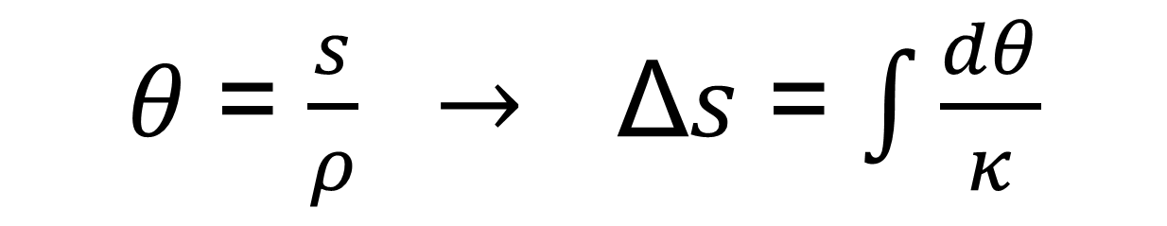
Road Curvature Decomposition for Autonomous Guidance
Ricardo Jacome, Mechanical Engineering Graduate Research Assistant, University of Nebraska -Lincoln
Jacome, Sweigard, Stolle
OBJECTIVE
DESIGN CRITERIA
MODEL IMPLEMENTATION
Develop a method for discretizing geospatial data and providing path guidance for autonomous vehicles.
Objectives & Criteria
AASHTO Base Model
300
250
200
150
100
50
300
250
200
150
100
50
BACKGROUND
0 100 200 300 400
0 100 200 300 400
Vehicle autonomy has been touted as the future of transportation, but there are significant challenges which remain to be addressed.
Tremendous growth has been achieved in “Advanced Driver Assistance Systems”
Google Earth Model
x10⁶
4.5465
4.5460
4.5455
4.5450
x10⁶
4.5465
4.5460
4.5455
4.5450
Road with Discrete Curvature Sections
7.265 7.27 7.275 7.28 7.285 x10⁵
7.265 7.27 7.275 7.28 7.285 x10⁵
GPS Model
400
200
0
-200
-400
500
400
300
200
100
0
-100
-200
-300
METHOD FORMULATION
-800 -400 -200 0 200 400
-800 -400 -200 0 200 400
*Where x-axis denotes Horizontal Coordinates
And y-axis denotes Vertical Coordinates
𝑎= 𝑣̇ 𝑇 + 𝜅𝑣² 𝑁
Where:
a = Total Acceleration of Vehicle (m/s²)
v = Tangential Velocity of Vehicle (m/s)
𝜅 = Curvature at an Instantaneous Point (m⁻¹)
N = Normal Unit Vector
T = Tangential Unit Vector
𝜃 = $\frac{s}{ρ} →$Δ𝑠 = $\int{\frac{dθ}{κ}}$
CONCLUSIONS & FUTURE WORK
Net
Component testing suggested d
Design
ACKNOWLEDGMENTS: MwRSF’s Outdoor Proving Grounds Manager, Test Technicians, and Students for conducting tests

